Slide 1
Overview
Demersal Ecosystem

Slide 2
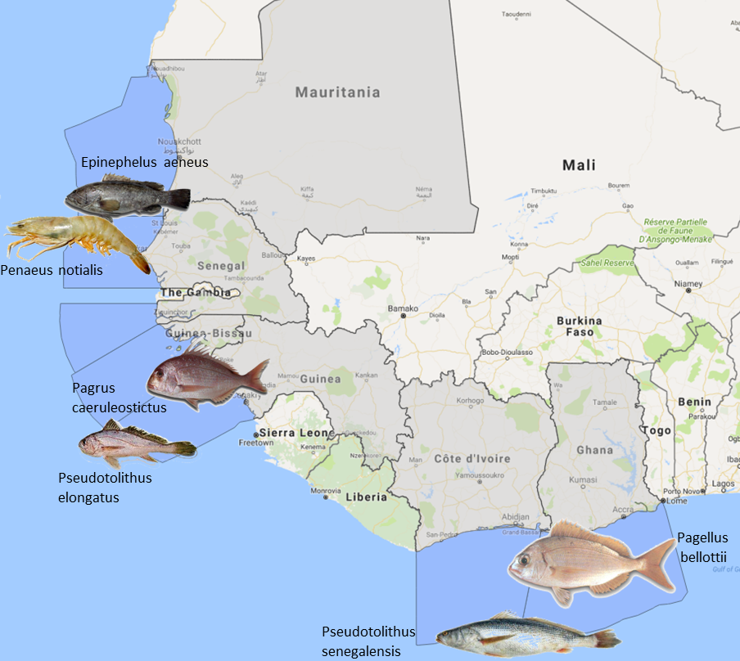
Overview
Demerstem project aims to improve knowledge on Demersal Shared Stocks
Scientific
Advice production
Capacity building
Improve knowledge
Monospecific /
Ecosystemic
Fleet monitoring
Essential habitat

Slide 3
WP1 - Scientific Advice Process
Data availablity
1
Improve availability of existing data for stock assessement :
Standard format for survey data
Backup
Meta data on existing data publicy available
Common toolbox to access data

Slide 4
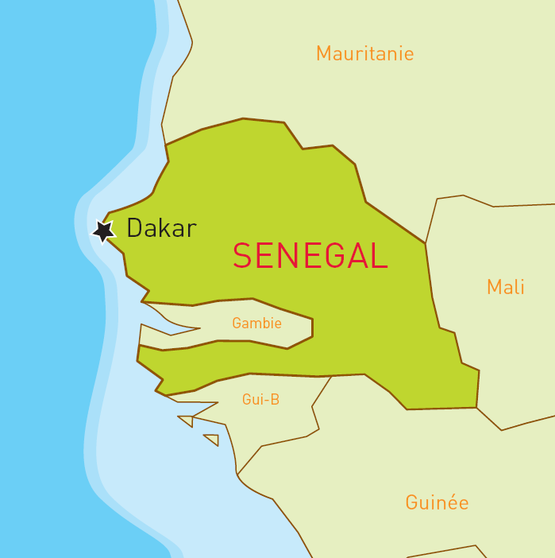
WP1 - Scientific Advice Process
Stock Identification
Improve stock Identfication (genetics, morphometric tools)
2

Slide 5
WP1 - Scientific Advice Process
Stock Identification
Improve stock Identification (genetics, morphometric tools)
2

Slide 6
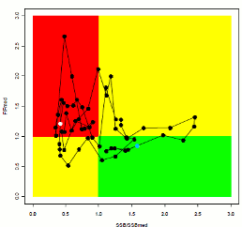
WP1 - Scientific Advice Process
Stock Assessment
Stock assessment and scientific advice for at least selected shared stocks.
Trials of new methods (non CECAF one)
Capacity building to set up a team of common skills at the regional level
3

Slide 7
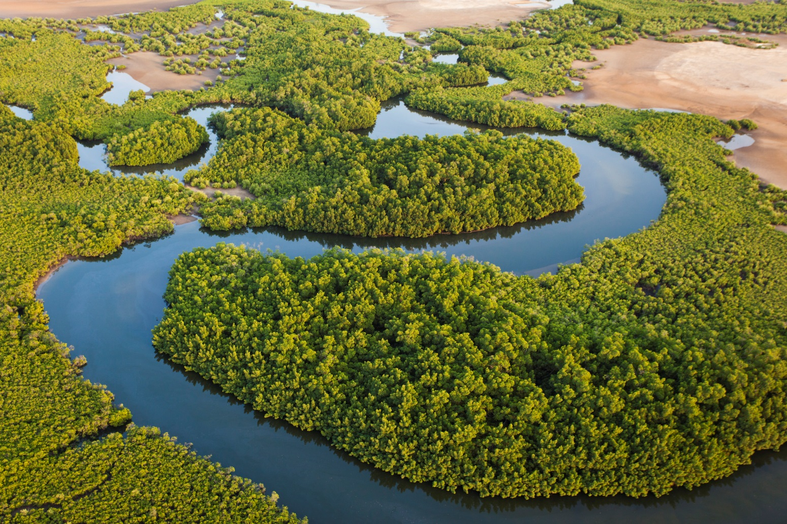
WP2 – Essential fish habitat
A keypoint to increase available biomass for fisheries should be to have a better regulation on essential fish habitat where a high level of mortality occurs.
WP 1

Slide 8
WP3 – Fisheries monitoring
New technologies (GPS) allow a better spatial knowledge on Artisanal fisheries activity. We can use these new tools to assess fisheries impact especialy
on Essential
Fish Habitat.
WP 1

Slide 9
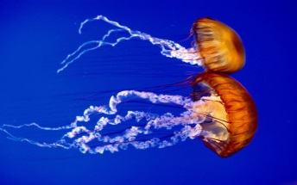
WP4 – Ecosystemic Approach
Classical Stock Assessment is useful but trophic interactions can give use a more realistic (and more complex) point of view on the Ecosystem.
We can use standards tools (indicators, Ewe ..) or we can focus on a specific trophic interaction issue

Slide 10
WP5-6 – Management and dissemination
WP5 – Management should be a shared responsability within the DEMERSTEM project. (even if Agrocampus Ouest is the leader of the project)
Internal Managment (WP leaders)
Scientific Comitee
External Board (Another point of view on our project)

Slide 11
WP5-6 – Management and dissemination
WP6 – Dissemination : we are producing knowledge for external users
Regional fisheries body
National, regional or world institutions in charge of fisheries managment)
Others (public)
And to scientific community more generaly.
A knowledge that is not disseminate will disappear.

Slide 12
Transversal WPs
Developping regional skills
Working together (at stock or regional level) within a community of scientist (as ICES)
Increasing availability (Viewability ?) of regional scientific production
And we are just at the begining of our project ….we are here at this meeting to transform a proposal to concrete action NOW !!

Slide 13
Be aware of other project for complementarities
DEMERSTEM is a project within the PESCAO CALL
DEMERSTEM
GREPPAO
FAO / CECAF

Slide 14
Be aware of other project for complementarities
PESCAO itself is one of all the West african project for fisheries
FAO
CSRP / MAVA..
All national project
PESCAO
Component 1 and 3
UEMOA
CPCO

Slide 15
Thanks

