Slide 1
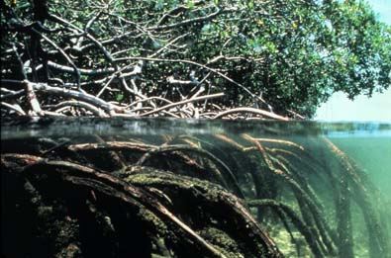
WP2 – Define coastal essential fish habitat for the demersal community
Demersal Ecosystem
1. Scientific context
2. Data availability
3. Mapping essential fish habitats
4. Estimate of their influence on stock renewal

Slide 2
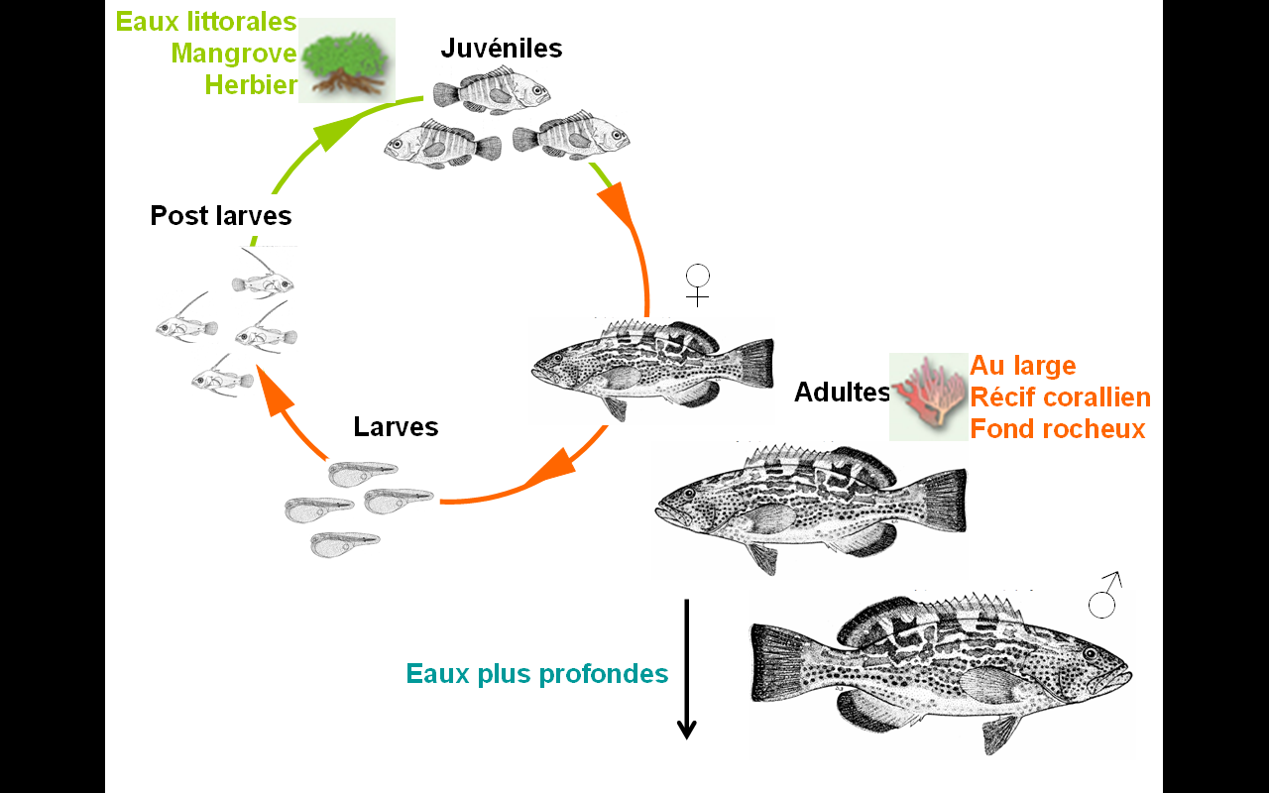
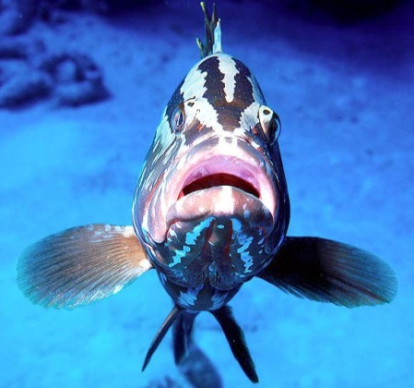
WP2- 1. Scientific context
What is a fish habitat: the life cycle
Mangrove
Seagrass
Juvenile
Post-larvae
Coral and rocky reefs
Adult
Larvae
Fish habitat
« at least one life stage
Deep water

Slide 3
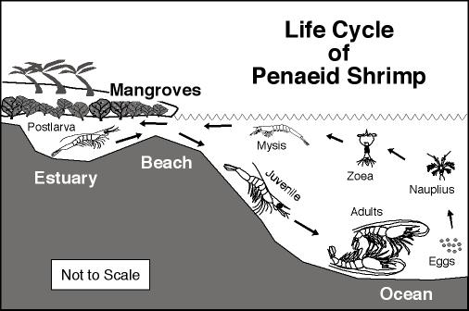
WP2- 1. Scientific context
What is a fish habitat: the life cycle
Fish habitat
« at least one life stage »

Slide 4
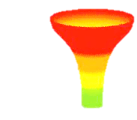
WP2- 1. Scientific context
What is a fish habitat
Fish habitat
Larval drift zones
Nurseries
Adult feeding zones
Spawning areas
Migration route
Specific population dynamics, low eggs to adult survival (≈ 1/100000)
High resilience to human catches / land or fresh water species
Strong habitat requirements, high dependency

Slide 5
WP2- 1. Scientific context
What is an essential fish habitat
Fish habitat
Larval drift zones
Nurseries
Adult feeding zones
Spawning areas
Migration route
Specific population dynamics, low eggs to adult survival (≈ 1/100000)
High resilience to human catches / land or fresh water species
Strong habitat requirement → Essential fish habitats
Level of importance
Concentration
Bottleneck
Contribution (overall & / unit area)
to population is high
Nurseries
Spawning areas
(Beck et al., 2001; Dahlgren et al., 2006)

Slide 6
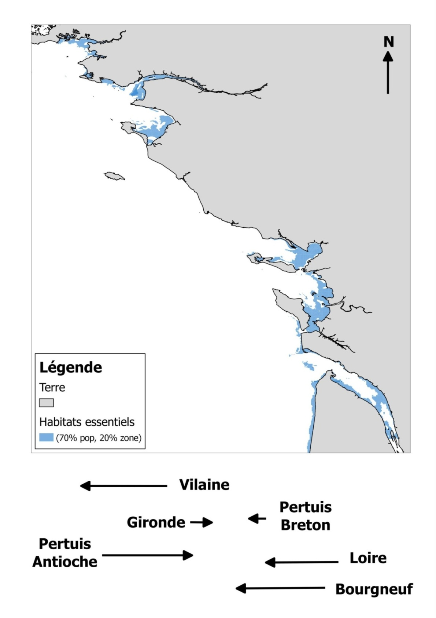
WP2- 1. Scientific context
What is an essential fish habitat
Flatfish nursery grounds
in the Bay of Biscay
Essential nursery habitats
  Dependence to estuarine & coastal nurseries
  30% of species & 66% of landings
  (ICES evaluated species ; Brown et al., 2018)
  A similar and sometimes even stronger
  (but less coastal) concentration for spawning areas
  A need for the same knowledge in West Africa
  Demerstem, WP2
(Trimoreau et al., 2013)

Slide 7
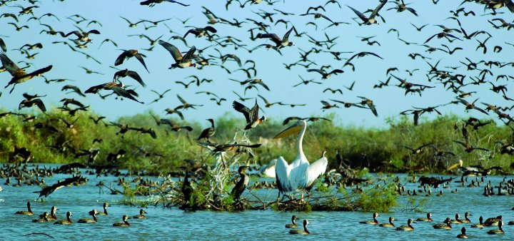
WP2- 1. Scientific context
What is an essential fish habitat
  A need for the same knowledge in West Africa
  Demerstem, WP2
Species | Coastal nurseries | Coastal spaning grounds
Epinephelus aeneus | Yes | partial (15-30 m)
Pagrus caeruleostictus | Yes | Yes
Pseudotolithus elongatus | Yes | Yes
Pseudotolithus senegalensis | Yes | Yes
Pagellus bellottii | Yes | Yes
Penaeus notialis | Yes | Yes

Slide 8
WP2 – 2. Data availability
Existing knowledge on coastal dependency
Worlwide on scientific litterature
And locally
Locally: Inventory of preliminary works
Experts in the group
Species | Coastal nurseries | Coastal spaning grounds
Epinephelus aeneus | Yes | partial (15-30 m)
Pagrus caeruleostictus | Yes | Yes
Pseudotolithus elongatus | Yes | Yes
Pseudotolithus senegalensis | Yes | Yes
Pagellus bellottii | Yes | Yes
Penaeus notialis | Yes | Yes

Slide 9
WP2 – 2. Data availability
Going further
The coastal fraction of (a part of the) surveys on fisheries resources
Survey | Area | Scientific structure | Nurseries | Spawning hab.
Pêche Guinée | Plateau guinéen | CNSHB, ENSAR et IRD | Yes | Yes
EAF Nansen | « Guinée-Maroc » et « Benin, Togo, Ghana & Cote d'lvoire”
LANGAMAU (IEO-Observers onboard shrimper trawlers)- P. notialis (spawners) |  | IEO
N/O Al Awam (hauturier) | Plateau continental mauritanien et radiales zone nord et centre pour le suivi mensuel du poulpe | IMROP | Yes | Yes
N/O Amrigue (côtier) | Zone côtière mautitanienne | IMROP | Yes | Yes
N/O Al Awam (hauturier) | Plateau Guinée Bissau | CIPA et IMROP | Yes | Yes

Slide 10
WP2 – 2. Data availability
Specific coastal surveys
Collating existing data
Suggesting needs for additional knowledge
But no new surveys implemented in the project
Survey | Scientific structure | Nurseries | Spawning hab.
baie du Lévrier et Banc d’Arguin (Mauritanie) | IMROP | Yes | Yes
Sine Saloum (Sénégal) | CRODT, IRD | Yes | Yes
Zone côtière (Sénégal) | CRODT | Yes | Yes
lagune du Grand Lahou,, Côte D’Ivoire | CRO et Universités
Guinea-Bissau (Dentex spp) | IEO-CIPA (GUINEA-BISSAU 0810 & others)
Zone côtière (Guinée) | CNSHB, ENSAR, IRD | Yes | Yes

Slide 11
WP2 – 2. Data availability
Maps of habitat descriptors
Bathymetry
Substrate cover
Productivity and other layers (with WP4)
Etc,

Slide 12
WP2 – 3. Habitat mapping
1. Develop an habitat suitability model (HSI)
  1.1. Merge fish data and environmental factors
n1 potential environmental descriptors ↔ n2 survey data
  1.2. Choose, fit then evaluate and validate an HSI
Presence/Density(species or life stage) = f(environmental factors)
2. Create predicted maps
Map of 1 environmental descriptor
(static or temporal)
1 survey data (position, date)
1 associated value for this descriptor
Density
Factor 1
Factor 2
Maps of
environmental descriptors
Habitat suitability map
Prediction with
HSI model

Slide 13
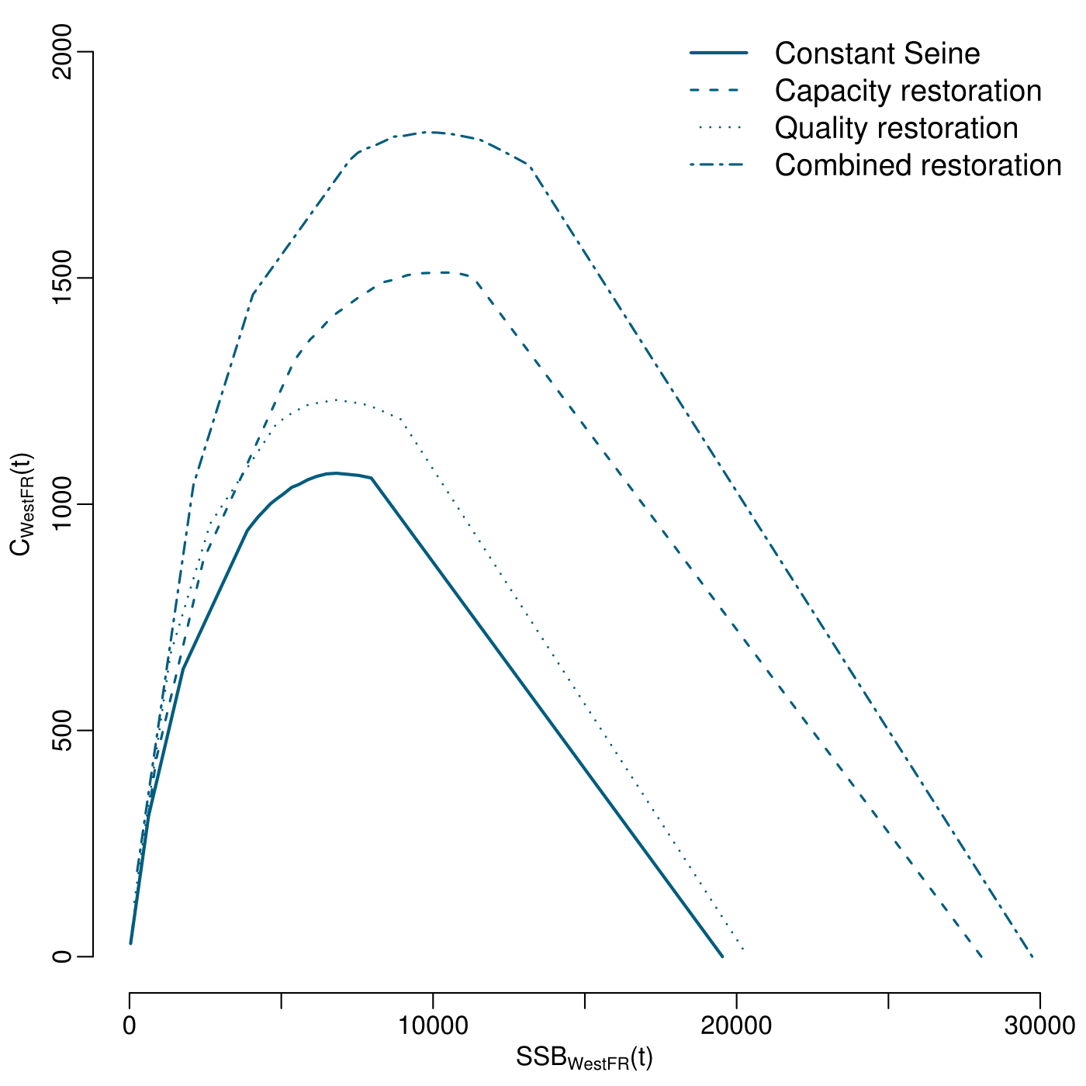
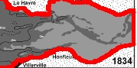

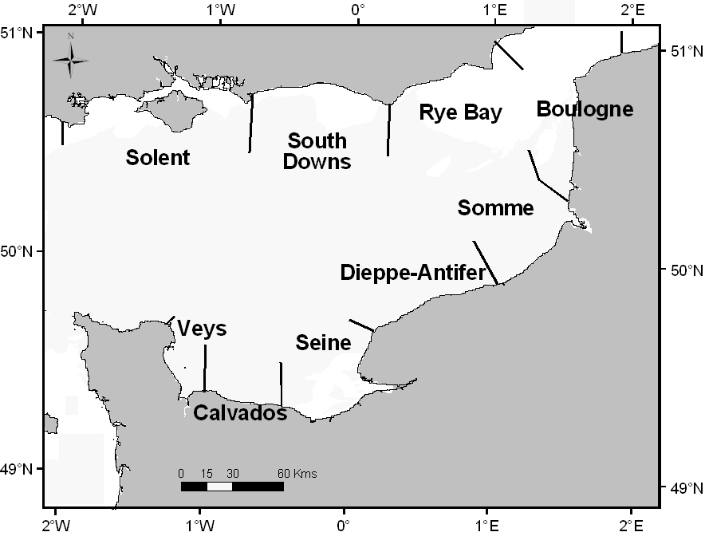
WP2 – 4. Toward management
Integrating essential fish habitats into fisheries management (with WP1)
Example of the common sole in the Eastern Channel
In the Seine estuary
+80% surface,  juv. Density
In the bay of Seine
+66% of biomass & catches
At the pop. Scale
(Eastern Channel)
+36% of biomass ; + 20% of catches
(Archambault et al., 2018)

Slide 14
WP2 – Define coastal essential fish habitat for the demersal community
Demersal Ecosystem
Thanks for your attention,
any question?

