Slide 1
WP4 – Biodiversity & Ecosystem approach to demersal resources & fisheries
Demersal Ecosystem
Focus on:
Spatio-temporal trends of demersal biodiversity, in particular demersal fish
Influence of changes in demersal habitats and in fishing pressure on demersal fish stocks

Slide 2
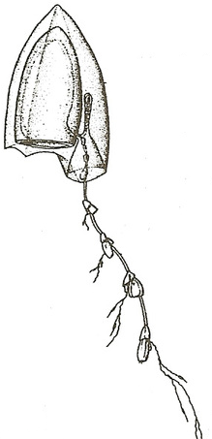
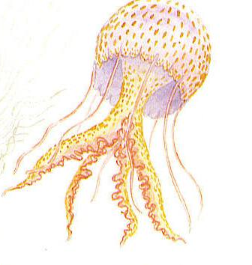
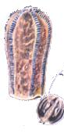
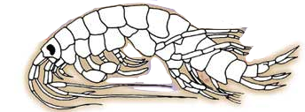
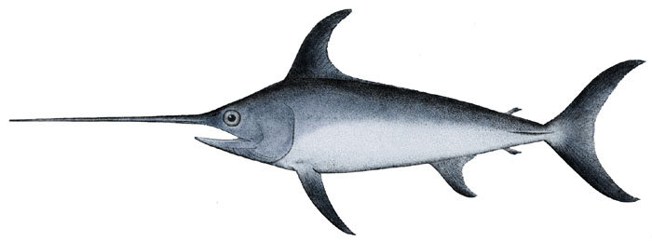
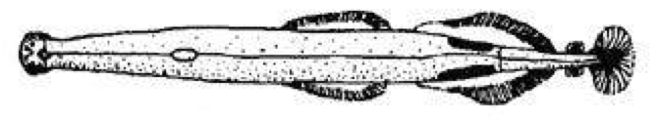
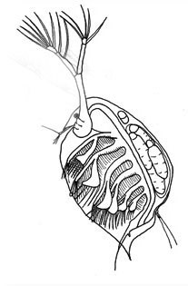
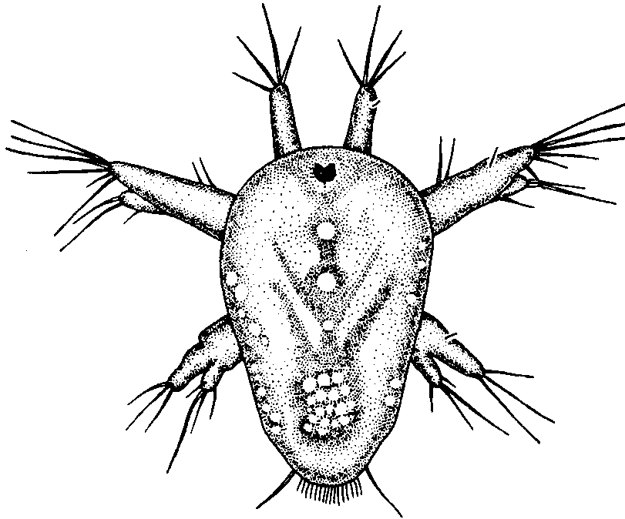
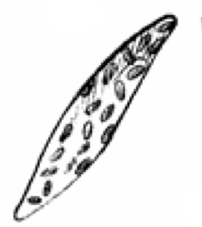

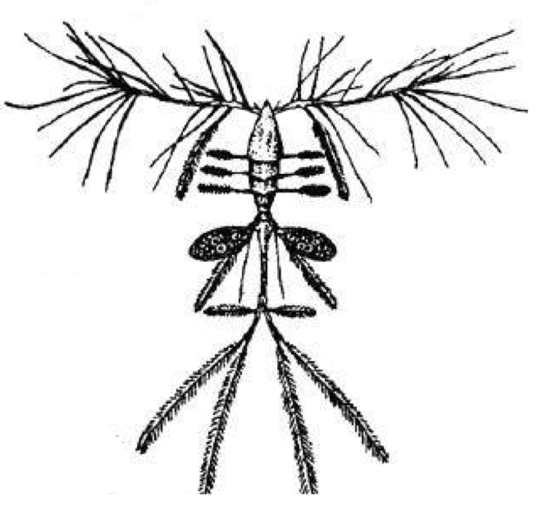

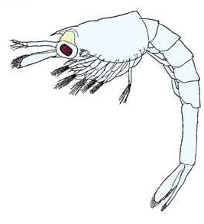

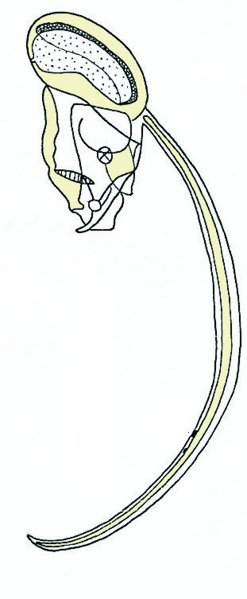
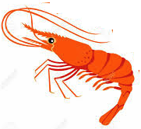
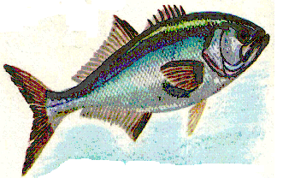
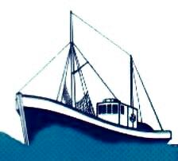

Marine Food Web
COMPETITORS
Zooplankton
PREDATORS
TOP PREDATORS
Zooplankton
RECRUITMENT
Trophic interactions affecting larval stages
Larval stages
Phytoplankton
positive effect
PREY
Zooplankton
negative effect
Adult SSB
PREDATORS
Climate change
Fishing pressure
© P. Licandro

Slide 3
WP4 – Specific objectives
Demersal Ecosystem
Improved knowledge on plankton biodiversity and distribution (Mauritania & Guinea case studies);
Evaluation of the impact of jellyfish on demersal resources (Mauritania & Guinea case studies);
Identification of key ecosystem indicators (states and trends);
Improved regional Ecosystem models (Ecopath/Ecosim);

Slide 4
Plankton diversity and distribution
Zooplankton in Tabounsou bay (Conakry, Guinea)
Zooplankton abundance during the dry season
Zooplankton biomass during the rainy season
Zoo. density
Temp.
Dissolved oxygen
Relationship between zooplankton and abiotic environmental factors (years 2014-2015)
Camara M., 2016. PhD, Ecole Doctorale CERESCOR

Slide 5
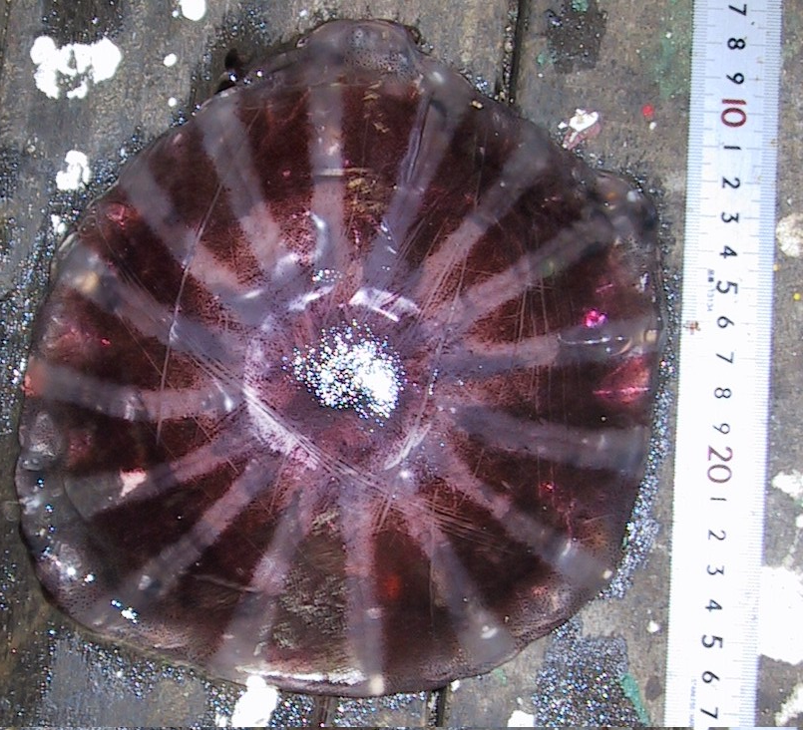
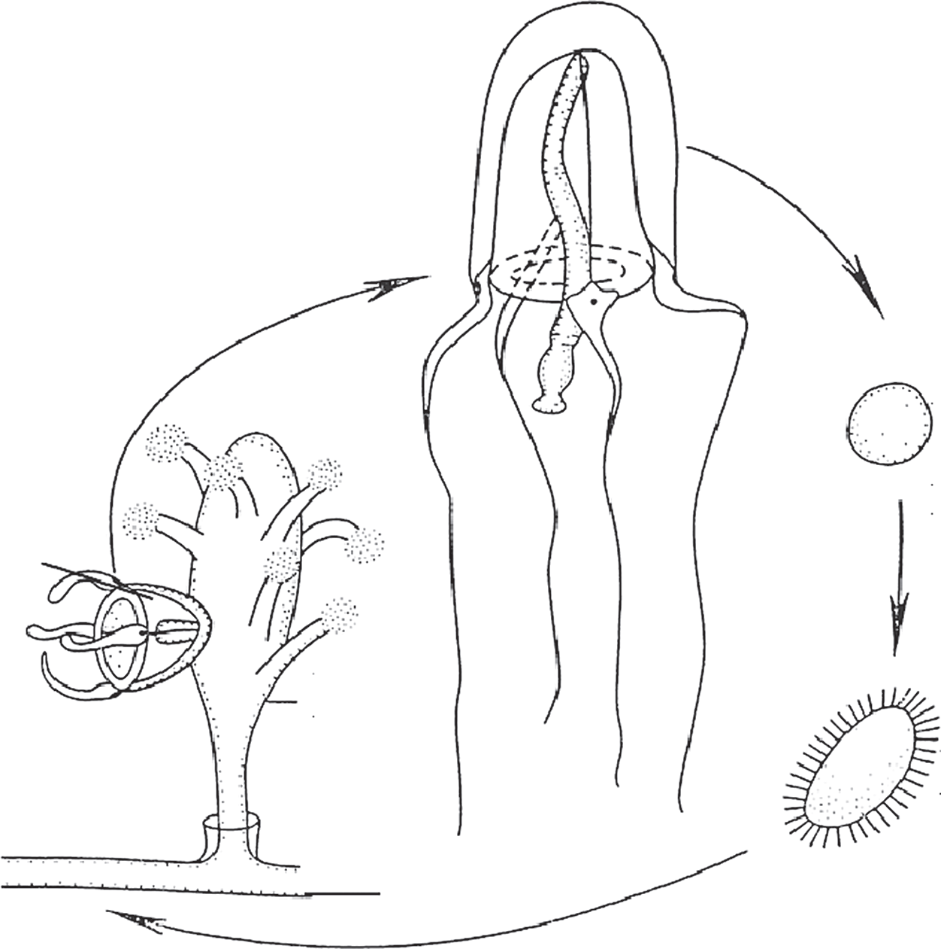
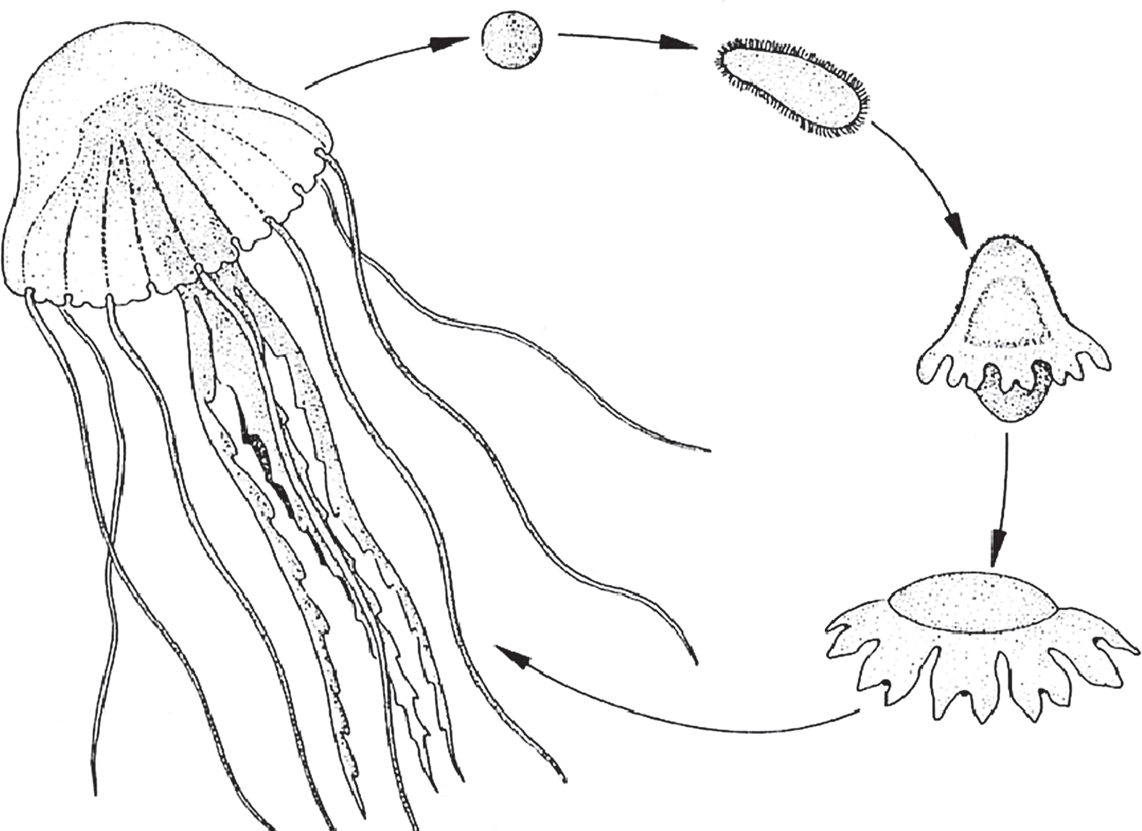
Impact of jellyfish on demersal habitats
Jellyfish might represent up to 90% of fish catches
m. oloplanctonique
m. meroplanctonique
Source : Licandro et al., 2018
Investigate jellyfish diversity and identify key jellyfish species
2) Map jellyfish distribution
3) Study interactions between jellyfish
and demersal fish stocks
Source : IMROP 2018
modified from: Cervantes, A. M. Bouzouma, et O. Roux (eds.) 2018. Rapports des Comités Scientifiques Conjoints République islamique de Mauritanie et l'Union européenne. Bruxelles, 213 pp.

Slide 6
Identify Key Ecosystem indicators
Identify taxa/species characterising the bulk of plankton productivity
Class 2, Class 3 (diatoms), Class 7 phytoplankton groups
Chlorophyll a concentration
Farikou O.S., et al., J. Geophys. Res. Oceans, 120: 6581-6601

Slide 7
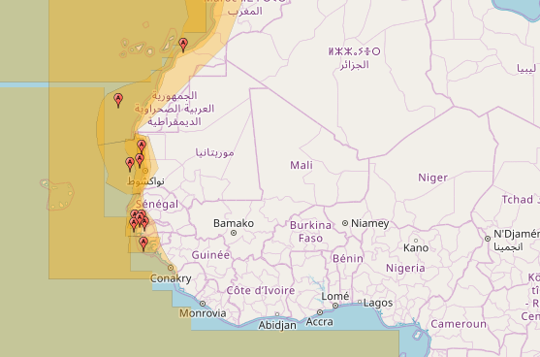
Improved regional Ecosystem models
ECOPATH/ECOSIM
In West Africa
(from Ecobase)
Objectives
1) Improve former regional EwE models: to integrate actualized data and new scientific knowledge
2) Produce new models : To cover new areas and/or new modelling approach (Ecotroph?)
3) Focus on the demersal ecosystem and on simulations of this ecosystem in the context of global changes
4) Improve WA regional expertise on Ecosystem Modelling

Slide 8
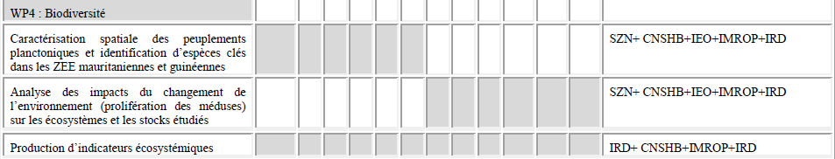
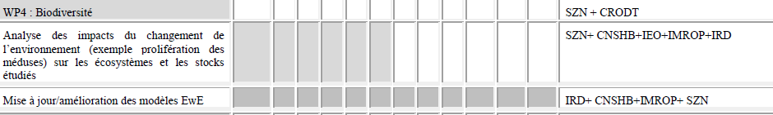
WP4 – Action Plan
Année 1
Année 2
Année 3
WP 4

Slide 9
WP4 – Ecosytem approach
Main topics of discussion at kick off meeting :
1) Inventory and description of databases
2) Discussion on scientific surveys, in conjunction with WP2
3) Identification of (local / vs regional ) ecosystem issues (to study and document)
4) Indicators of ecosystem (biodiv, Env) trends and states
5) Ecosystem modelling (Ecopath/Ecosim et autres)
6) Valorisation policies and planning
WP 4

